Slide 1
Machine Learning Applications in Real Estate Valuation
A Data-Driven Analysis of the Ames Housing Market

Slide 2
Dataset Overview
Analysis of 22,213 properties in Ames, Iowa
173 detailed features per property
Data spans multiple years of real estate transactions
Different types of property characteristics: structural, location, quality metrics

Slide 3
Business Questions
Primary Business Objectives:
What drives house prices in the Ames market?
Can we create accurate automated valuation models?
How do different property features impact value?

Slide 4
EDA
Systematic outlier detection using multiple methods:
IQR for price data
Z-score for area measurements
Statistical methods for count variables
Missing value imputation based on neighborhood patterns
Feature engineering created 17 refined metrics
Quality score normalization across categories

Slide 5
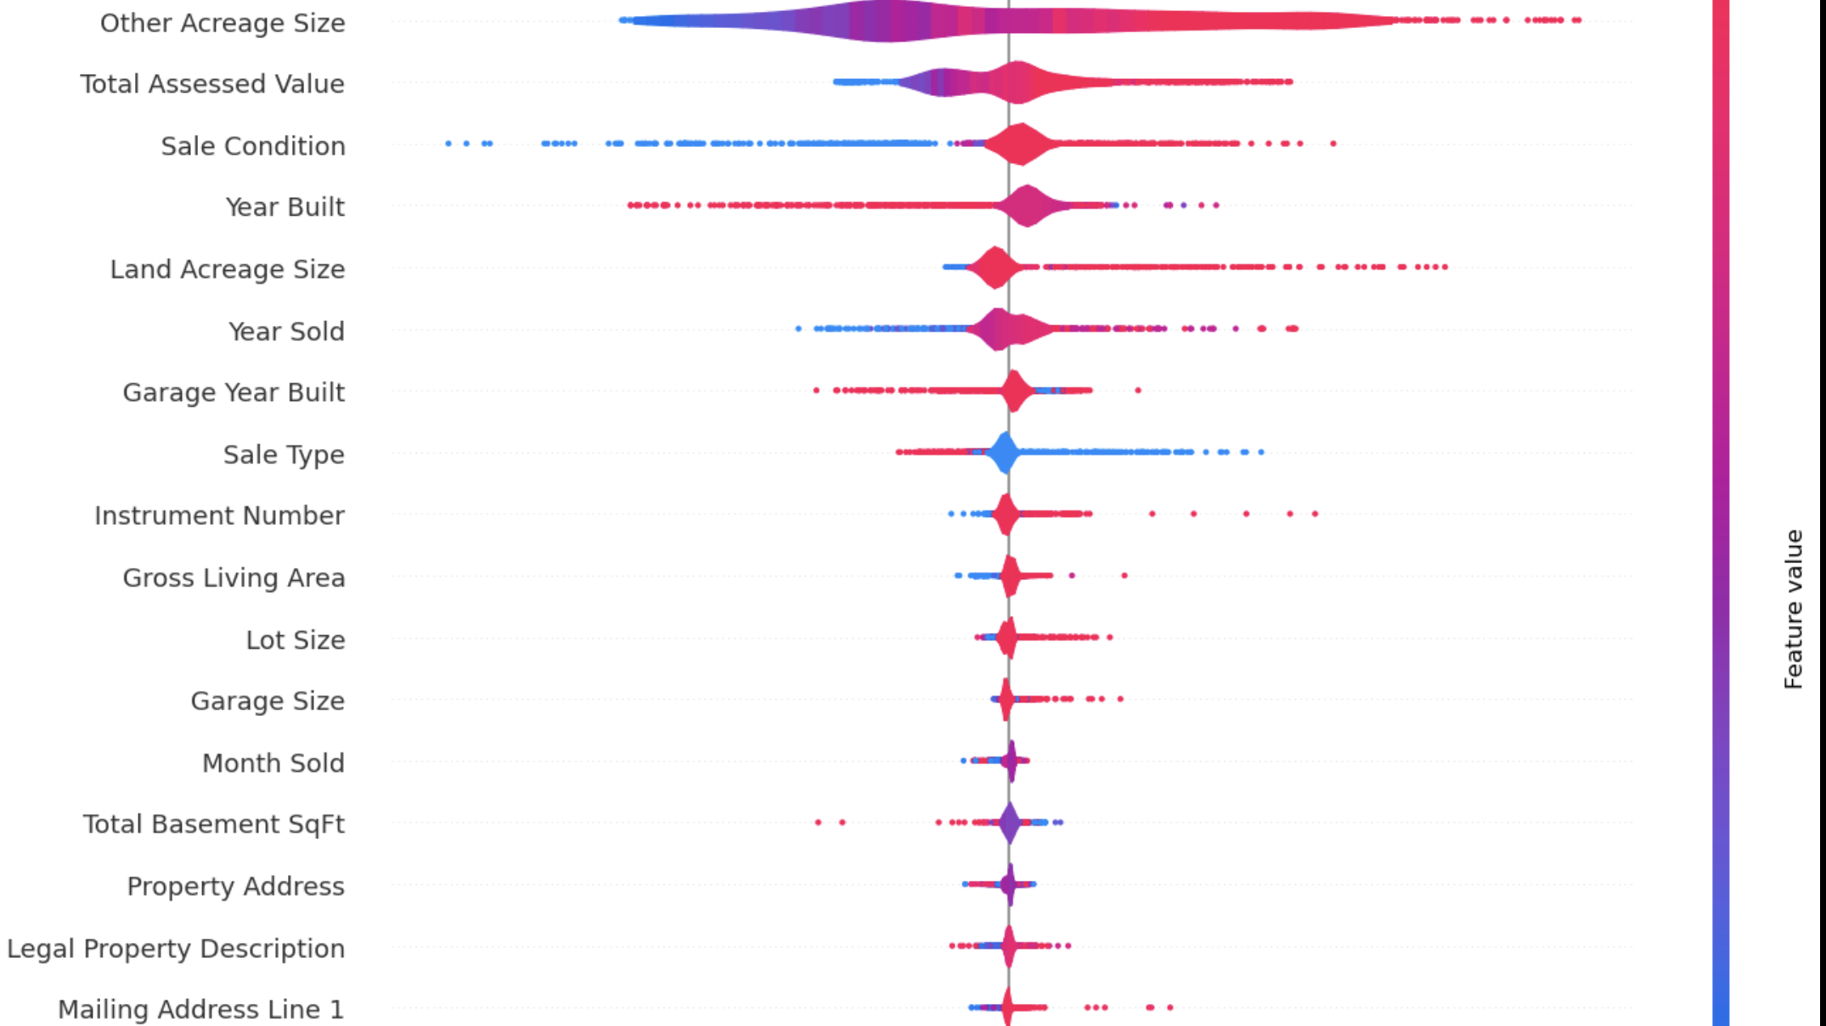
SHAP GRAPH FOR STRONGEST MODEL
Notes:
Based on xgboost, my strongest model Most Influential Features:
Other Acreage Size - How much additional land besides the main house plot (measured in acres)
Total Assessed Value - The value of the property as determined by the government for tax purposes
Sale Condition - Special circumstances of the sale (like foreclosure, normal sale, short sale, etc.)
Year Built - When the house was constructed
Land Acreage Size - Size of the main plot of land the house sits on (in acres)
Middle-Impact Features:
Year Sold - When the property was purchased
Garage Year Built - When the garage was constructed
Sale Type - Method of sale (like warranty deed, quitclaim deed, etc.)
Instrument Number - The official recording number for the property transaction document
Gross Living Area - Total livable square footage of the house
Lower-Impact Features:
Lot Size - The official recorded size of the property plot
Garage Size - Square footage of the garage
Month Sold - Which month the property was purchased
Total Basement SqFt - Square footage of the basement
Property Address - Physical location of the house
Legal Property Description - Official description of the property boundaries in the deed
Mailing Address Line 1 - Address where the property tax bill is sent

Slide 6
Model Performance Analysis
Boost Accuracy: Achieved highest performance with R² = 0.8825 on test data
Gradient Boosting: Second best with R² = 0.8411, showing consistent performance with advanced boosting approaches
Random Forest: Achieved R² = 0.8327
Neural Network: Standard implementation achieved R² = 0.5370
Ensemble Method: Achieved an R² of 0.8347
Traditional Models:
Linear approaches showed limited performance: Ridge: R² = 0.4812
Lasso: R² = 0.4792
Linear Regression: R² = 0.4782
Notes:
Put more text here Split this into two slides, One slide on model performance that tells about accuracy and recall and general accuracy, focus n that being one sldie
Then have another slide that talks about the key value drivers. Actually say the column names. Have A graph that s a feature importance graph in xgboost and put it in that second slide.

Slide 7
Key Value Drivers - XGBoost Analysis
The biggest influence on house prices is the air conditioning system type (OthAc_S)
How the house was sold (foreclosure, normal sale, etc.) is the second most important factor
The age of the garage and the size of the lot have similar levels of importance in determining price The adjusted yearly value of the property has some influence, but not as much as the above factors
The neighborhood and the type of sale (conventional, VA loan, etc.) matter about the same amount
Less important but still noteworthy factors include:
The overall condition and quality of the house
What year the house was sold
The type of stone or brick on the front of the house (masonry veneer)
The least important features include: Miscellaneous added value items
Street suffix (Ave, St, Rd, etc.)
How efficiently the living space is used
The total living area
Notes:
Show Feature Importance and Correlation in ML Project

Slide 8
Analyzing Correlation Tables
Random Forest Model:
The real drivers are not what you'd expect - structural features like air conditioning type (OthAc_S) have 3x more impact than traditional value indicators like living area or lot size
Transaction characteristics (SaleCond) matter significantly - how a house is sold has almost as much influence as its physical attributes
XGBoost Model:
Land and value metrics cluster together - land acres (LndAc_S) and total value (TtlVal_AdjYr) show strong correlation (0.96), suggesting they move in tandem
Shared Across Models:
Physical feature hierarchy is clear - core building systems (AC, garage) consistently outrank cosmetic features in importance across both models
Traditional value drivers like living area (GLA) and room count appear at the bottom of importance rankings, challenging conventional wisdom
Notes:
Put the insights here

Slide 9
Key Recommendations to Sellers and Buyers
For Sellers:
Focus on Lot Value Optimization
Property size and acreage have the strongest impact on value (top of SHAP graph) so you should consider highlighting unique lot features or development potential
Timing and Transaction Strategy is Critical
Sale condition significantly impacts price (3rd highest in SHAP). The year and timing of sale shows meaningful impact plus the type of sale (conventional, VA loan, etc.) also meaningfully affects outcomes.
For Buyers:
Prioritize Core Value Metrics
Look beyond basic living area - acreage and total property size show stronger value impact
Consider land characteristics over interior features
Watch Transaction Factors
Sale conditions and type significantly affect price
Property age (year built) influences value more than recent upgrades

Slide 10
Critical Missing Data & Future Research
Model Performance Context: Our XGBoost model achieved an R² of 0.8825 (explaining 88.25% of variation, not 89%), while other models showed varying performance (Ridge: 0.4812, Gradient Boosting: 0.8411). Future improvements should focus on the ~12% unexplained variance.
Areas for Future Research:
Improve model convergence (multiple warnings about convergence in Lasso model)
Resolve matrix conditioning issues observed in Ridge regression
Investigate why linear models performed significantly worse than tree-based models
Notes:
Less text, start each bullet with text beforore the colonj be bolded

